Slide 1
Delivering a sustainable and future-proof railway in CP5 - and beyond
Institution of Railway Operators
10th February 2014
Tony Berkeley – Chairman, Rail Freight Group

Slide 2
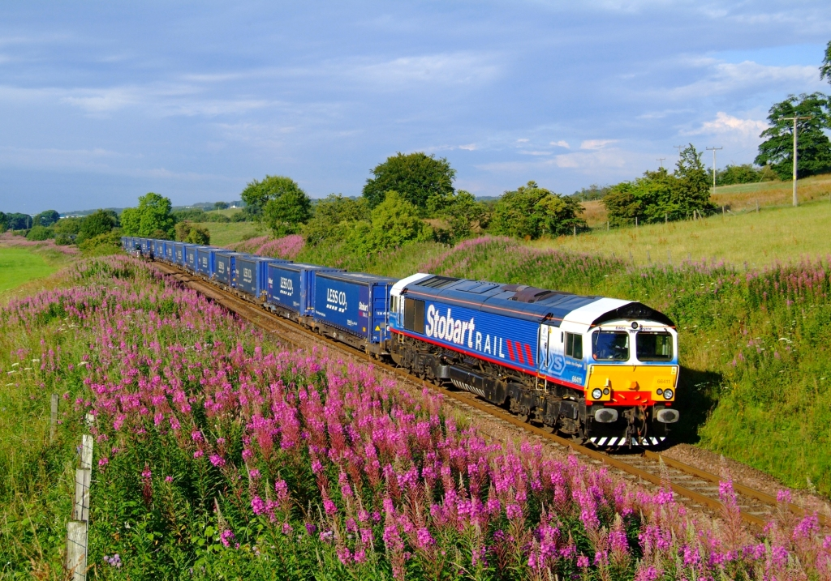
Today’s rail freight is evolving.
Notes:
Can talk about mix of markets today. Intermodal now 1/3, greater use by retailers, 7 operators, etc

Slide 3
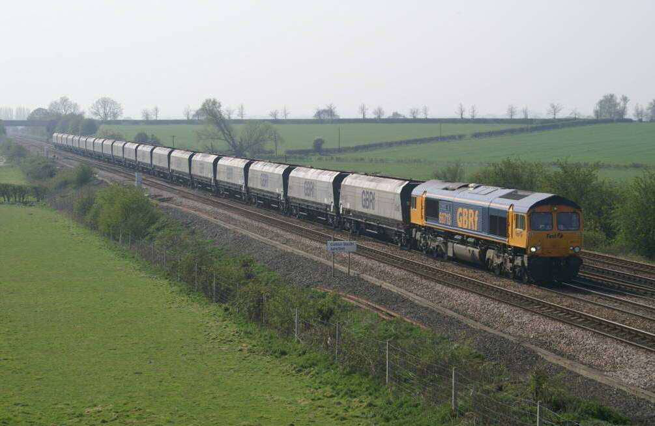
New markets are coming to rail.
Notes:
New markets not just retail also bulk like biomass – demanding requirements etc

Slide 4
Efficiency is improving.
Notes:
Efficiency improved – 30% more per train than in past.

Slide 5
Rail freight forecast growth
2033/4 Daily freight trains sum of both directions, Mon-Fri average.
Source MDS Transmodal

Slide 6
Rail freight forecast growth
2033/4. Average freight trains per weekday. Sum of both directions. West Midlands area
Source MDS Transmodal

Slide 7
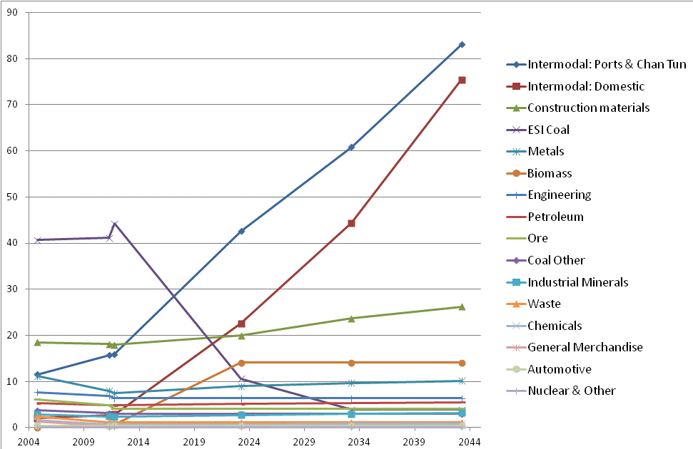
UKUKU
Rail freight forecasts by commodity
Source MDS Transmodal
Rail Freight history and forecasts by sector / commodity. Million Tonnes

Slide 8
How do we deliver further growth?
More capacity.
Greater efficiency.
Cost competitiveness.
Investment in equipment and terminals.
Electrification with freight capability
A part of logistics.
Notes:
What do we need for growth?

Slide 9
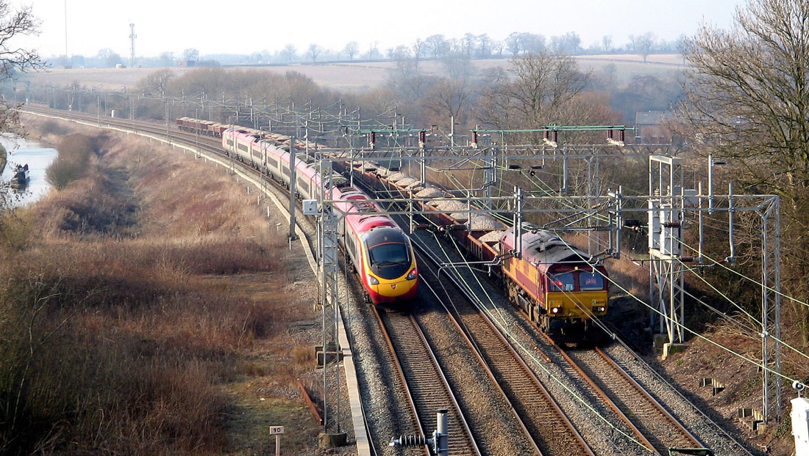
The rail network is congested.
Notes:
Capacity congested. Need to look at
Longer trains
Heavier trains
Overnight
Weekends
Better scheduling
Dynamic loops
Electrification
ERTMS
But ultimately need to build more capacity.

Slide 10
HS2 is vital for freight – and must deliver.
HS2 could take 500,000 HGV lorry journeys off the M1, M40 and M6 motorways each year leading to environmental benefits worth over £45 million per annum and saving over 65,000 tonnes of carbon dioxide emissions per annum WSP.
The carbon savings from using the additional unclaimed capacity of three train paths per hour in each direction for freight are considerably larger still, adding 55% to the direct carbon savings from HS2. This is such a strong advantage that it will be worthwhile examining complementary measures to ensure that a major switch from HGV road haulage to rail freight is achieved as a consequence of HS2. Greengage 21
Notes:
HS2 – here are the benefits. To deliver this need;
Rail freight fair share of released capacity
Solution where HS2 co-runs with existing network – and full integration with existing network.
Better HS1/2 connection
Freight capable

Slide 11
Network Rail - “Mega projects” will become more common as scope for incremental capacity solutions diminishes
Source: ‘Future’ Engagement Group meeting 20 September 2013

Slide 12
HS2 is vital for freight, but what happens at the ends?
HS2 will provide the extra capacity on the parallel WCML – effectively adding two more tracks.
Phase 1 rejoins the WCML around Litchfield; how to fit all the trains in, with rail freight forecast to double by then on this route?
Phase 2 moves the problem North of Warrington. What happens to freight and the extra passenger trains beyond there to Preston, Carlisle and Scotland?
It won’t fit without some major enhancements.

Slide 13
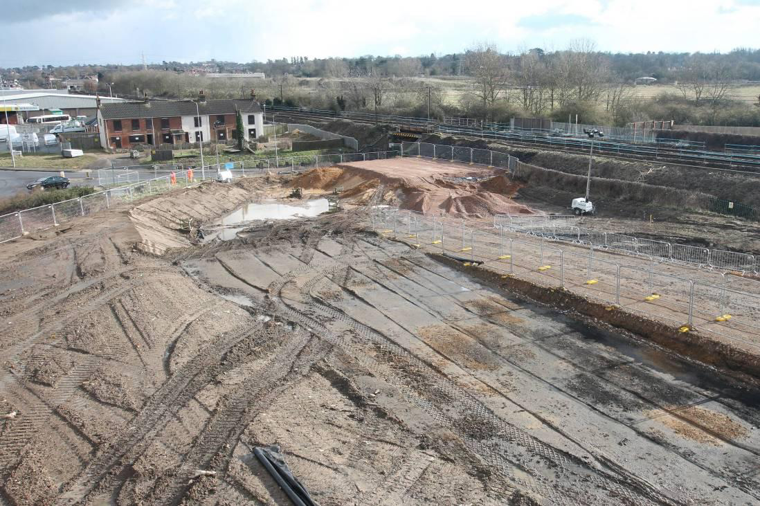
Efficiency needs to improve.
New Bacon Factory chord, Ipswich, under construction. Will allow Felixstowe-Peterborough trains to avoid reversal
Notes:
Need to keep pushing efficiency – road doesn’t stand still.
Pic is Ipswich chord, improves journey time. More of this and more collaboration, better equipment / asset usage etc.

Slide 14
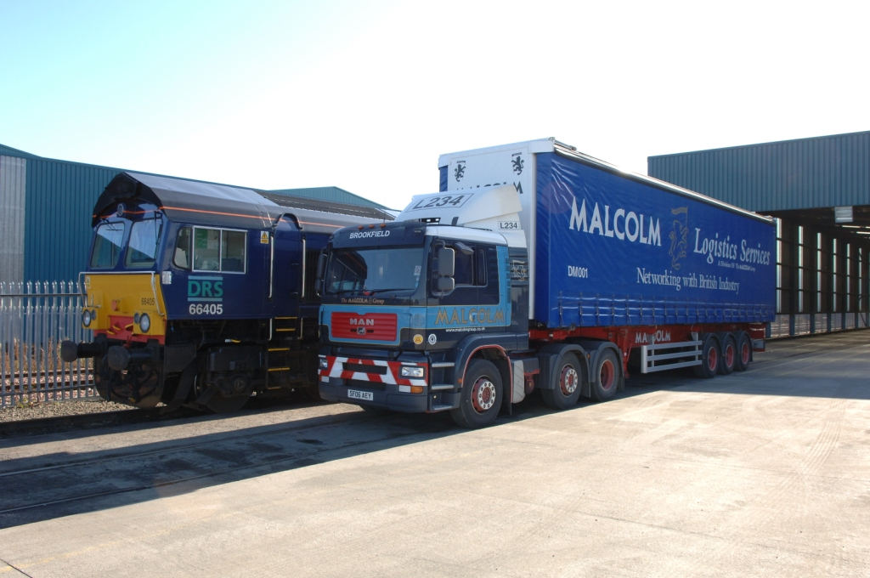
Rail must compete on cost with road.
Notes:
Chancellor has frozen fuel duty. Longer lorries, double decks all add to road efficiency. OK but rail must compete on price.
Pointless discussions on geographic access charges etc. – compete with road.
Road tolling – will it make a difference? Roads assessed on multimodal basis.
Get modes to play to their strengths.

Slide 15
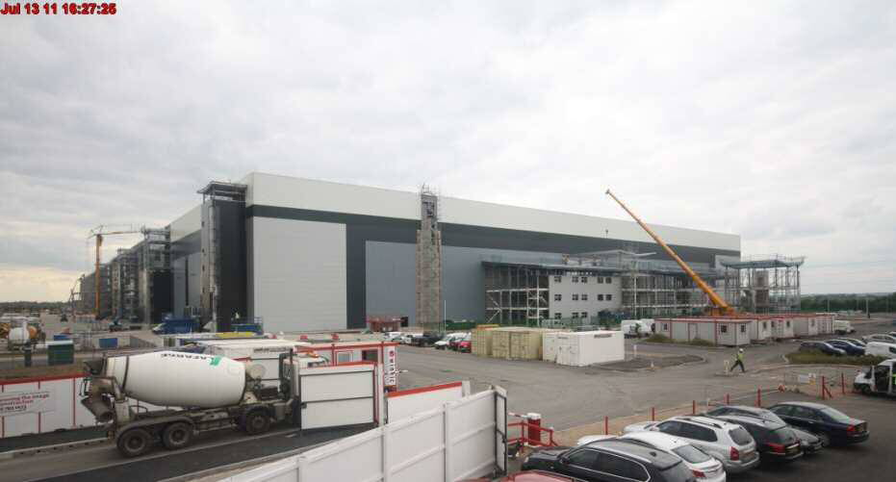
Investment needed in terminals and equipment.
Notes:
Sort out planning system and allow business to invest with certainty.

Slide 16


Rail needs to be a key part of logistics strategy.
Notes:
Integrate rail with logistics.
Talk about urban freight

Slide 17
The UK’s passenger service is better than most

Slide 19
Net cost to Government
UK € 4 bn, I € 6 bn, FR € 12 bn, D € 12 bn
Italy similar in size network to UK

Slide 20
The UK’s rail connection to the continent
Channel Tunnel opened in 1994
Carries road vehicles on shuttle trains
Through passenger services – Eurostar
Through freight services – DBSchenker and Europorte, part of Eurotunnel
Issues: Charges for rail freight very high
Infraction proceedings by European Commission against UK and French Government over charges and structure of Eurotunnel and lack of independent regulation
Legal appeal by Eurostar against tunnel charges

Slide 21
And France?
Like Spain and Portugal, the UK is separated from the rest of the European rail network by France…
EC infraction proceedings against France
French competition authorities fine SNCF Euro 60m for abuse of dominant position
Independent operators find it very difficult to obtain reasonable paths through France
SNCF’s freight volumes have fallen by around 50% in the last ten years, whereas in the UK freight volumes increased by 60%.

Slide 22
Rail freight in Europe – what next?
Competition above rail is an essential pre-requisite to growth. Otherwise freight will go more and more by road.
Separation of infrastructure from all train operators provides a fair and transparent basis for this.
Strong co-ordination between infrastructure managers, and safety and standards overseen by European Rail Agency
We should strongly support the European Commission’s attempt to achieve this through the 4th Railway Package; against very strong opposition from incumbents.

Slide 23
In the UK, the future is intermodal – by rail?
Intermodal freight transport is potentially the fastest growing sector for rail.
Demand is increasing significantly in the UK and Sweden
Road congestion and environmental pressures lead customers to want to use rail if they can
The logistics sector, with it is origins and reliance on road transport, leads the way in demanding similar service quality if rail is to be part of the logistics chain.
Logistics by rail must be cost and service competitive with road

Slide 24
Conclusion
Demand from customers, particularly in the intermodal sector, is growing.
To meet it, the industry needs:
- more terminals
    More capacity
    More loops and chords to allow longer trains
    24/7 operation
    More electrification for freight
    Reasonable and simple to operate charges
    Then we will divert 10m lorry journeys to per annum by 2034.

Slide 25
Thank You
tony@rfg.org.uk
www.rfg.org.uk
@railfreightUK

